Slide 1

Paragraph Processor Review Quiz
Submit UML diagram as answers to the questions in this quiz in the form of a JPG, PNG or PDF file. Please name each file LastNameFirstNameQuestion# and include a file extension. This is how you’ll submit them for the actual exams and it will help us grade.
You are not expected to run the code provided for these questions. The code does not need to be run in order to answer the questions, they have been provided as a reference to give you the best understanding of questions' context.
The code has been written without following many of the recommendations of this course. Your assignment is to take a look at the code provided, see how it has been designed, then refactor the design and provide a UML diagram showing your new, refactored design. You are not expected to submit code in your solution, you are only expected to submit the answer as a UML class diagram. Your UML must show all classes, methods, parameters, return values, attributes, data types, and scope for elements needed in your solution.
Continue
Notes:
Submit UML diagram as answers to the questions in this quiz in the form of a JPG, PNG or PDF file. Please name each file LastNameFirstNameQuestion# and include a file extension. This is how you’ll submit them for the actual exams and it will help us grade.
You are not expected to run the code provided for these questions. The code does not need to be run in order to answer the questions, they have been provided as a reference to give you the best understanding of questions' context.
The code has been written without following many of the recommendations of this course. Your assignment is to take a look at the code provided, see how it has been designed, then refactor the design and provide a UML diagram showing your new, refactored design. You are not expected to submit code in your solution, you are only expected to submit the answer as a UML class diagram. Your UML must show all classes, methods, parameters, return values, attributes, data types, and scope for elements needed in your solution.

Slide 2
Paragraph Processor Review Quiz
Note that, you are not expected to match the interface of the provided code. You are free to refactor the problem completely. As long as you maintain the overall functionality. Some problems are best solved using the design patterns you have learned in class, others do not require the use of design patterns.
To get full credit for a problem, you must determine if any design patterns are appropriate and if so, indicate which indicates design patterns you utilized and what classes represent the components of the design pattern within the UML as either a note or text annotation.
Please download the zip file (ParagraphProcessor.zip) which contains the improper code and when complete submit the UML.
Continue
Notes:
Note that, you are not expected to match the interface of the provided code. You are free to refactor the problem completely as long as you maintain the same overall functionality. As long as you maintain the overall functionality. Some problems are best solved using the design patterns you have learned in class, others do not require the use of design patterns.
To get full credit for a problem, you must determine if any design patterns are appropriate and if so, indicate which indicates design patterns you utilized and what classes represent the components of the design pattern within the UML as either a note or text annotation.
Please download the zip file (ParagraphProcessor.zip) which contains the improper code and when complete submit the UML.

Slide 3
Paragraph Processor Review Quiz
Please review the ParagraphProcessor.java code and create a UML diagram for the refactored design. The ParagraphProcessor class processes an input String, allowing it to be output to the console, to a PDF file (saved locally as output.pdf), or to audio. It can leave the text as-is, convert it to uppercase, or convert it to lowercase. It uses the iText library for PDF creation and the FreeTTS library for audio output.
Additionally, you should show how your solution interacts with the libraries (iText and FreeTTS). You don’t need to show every method or attribute in the library, just the public interface you would use in your solution.
Note: in order to run this program you would need to have both the iText library and the FreeTTS library. If you were to run the code, the libraries could be added manually with jar files, with maven, or with gradle. Remember, you do not have to run the code. We just include everything for reference.
Continue
Notes:
Please review the ParagraphProcessor.java code and create a UML diagram for the refactored design. The ParagraphProcessor class processes an input String, allowing it to be output to the console, to a PDF file (saved locally as output.pdf), or to audio. It can leave the text as-is, convert it to uppercase, or convert it to lowercase. It uses the iText library for PDF creation and the FreeTTS library for audio output.
Additionally, you should show how your solution interacts with the libraries (iText and FreeTTS). You don’t need to show every method or attribute in the library, just the public interface you would use in your solution.
Note: in order to run this program you would need to have both the iText library and the FreeTTS library. If you were to run the code, the libraries could be added manually with jar files, with maven, or with gradle. Remember, you do not have to run the code. We just include everything for reference.

Slide 4
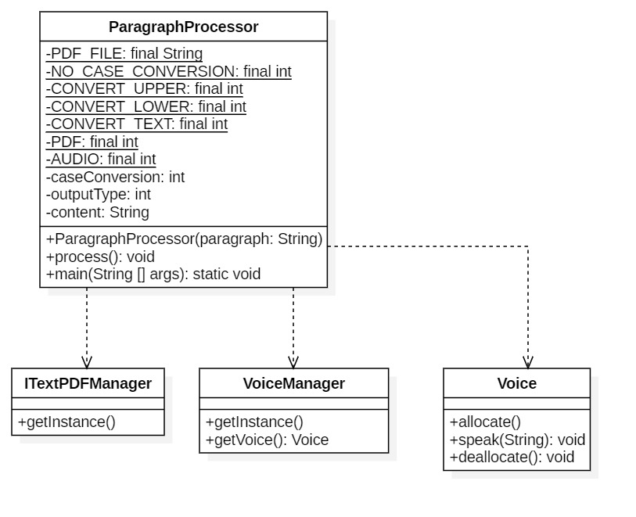
Paragraph Processor Review Quiz
What’s wrong with the original solution?
Continue
Notes:
So, what’s wrong with the entire solution.
For starters, the entire solution is in a single class with dependencies on external libraries.
This is not necessarily wrong in and of itself, but this is an object-oriented programming class, so the likelihood we would stick with a single class is rare.

Slide 5
Paragraph Processor Review Quiz
What’s wrong with the original solution?
public void process(){ // Output to console, no case conversion if(this.outputType == CONSOLE_TEXT && this.caseConversion == NO_CASE_CONVERSION){ // Not much to do here System.out.println(this.content); } // Output to console, convert to UPPER else if(this.outputType == CONSOLE_TEXT && this.caseConversion == CONVERT_UPPER){ // Convert to uppercase String upperContent = this.content.toUpperCase(); System.out.println(upperContent); } // Output to console, convert to lower else if(this.outputType == CONSOLE_TEXT && this.caseConversion == CONVERT_LOWER){ // Convert to lowercase String lowerContent = this.content.toLowerCase(); System.out.println(lowerContent); } // Output to PDF, no case conversion else if(this.outputType == PDF && this.caseConversion == NO_CASE_CONVERSION){ // Create a new PDF document Document pdfD = new Document(); // Initialize a writer instance try { PdfWriter.getInstance(pdfD, new FileOutputStream(PDF_FILE)); } catch(IOException | DocumentException e){ e.printStackTrace();
...
Continue
Notes:
Let’s dig a little deeper and look at the code.
What we see is one central method that does the heavy lifting.
In it the choices of case conversation and output format are coupled within the class and within individual conditional statements.
This means when a change in the form of a new case conversion or output format occurs, code related to both are changed.

Slide 6
Paragraph Processor Review Quiz
What’s wrong with the original solution?
// Output to PDF, no case conversion else if(this.outputType == PDF && this.caseConversion == NO_CASE_CONVERSION){ // Create a new PDF document Document pdfD = new Document(); // Initialize a writer instance try { PdfWriter.getInstance(pdfD, new FileOutputStream(PDF_FILE)); } catch(IOException | DocumentException e){ e.printStackTrace(); } pdfD.open(); int fontSize = 14; Font f = FontFactory.getFont(FontFactory.HELVETICA_BOLD, fontSize, BaseColor.BLACK); Chunk c = new Chunk(this.content, f); try { pdfD.add(c); } catch(DocumentException e){ e.printStackTrace(); } pdfD.close(); } ...
Continue
Notes:
Also, observe the code the outputs to a PDF with no case conversion.
This code accesses the itextpdf pdfWriter library directly creating tightly coupled code.

Slide 7

Paragraph Processor Review Quiz
Which design pattern is appropriate to solve this problem?
No Pattern
Facade
Adapter
Strategy
Bridge
Notes:
So which design pattern did you use to solve the problem? So far, we’ve learned the Façade, Adapter, Strategy and the Bridge. Also, you could try to solve it without a pattern. Click on the appropriate choice.
https://www.google.com/url?sa=i&url=https%3A%2F%2Fwww.deviantart.com%2Fadireflex%2Fart%2FAhsoka-Tano-159680024&psig=AOvVaw3VURbUYRQw0usAzT_mvA5B&ust=1593892156768000&source=images&cd=vfe&ved=0CAIQjRxqFwoTCPDQ6cjtseoCFQAAAAAdAAAAABAJ

Slide 8

Paragraph Processor Review Quiz
There’s any number of improvements you could make to this code to improve it. Let’s start with a basic reorganization along the lines of focusing on encapsulation the concepts that vary. Click the Continue button to see more.
Continue
Notes:
There’s any number of improvements you could make to this code to make it better. Let’s start with a basic reorganization along the lines of focusing on encapsulating the concepts that vary independantly. Click the Continue button to see more.
Click on the Return to Previous Screen button and try again.
https://swan2swan.tumblr.com/post/116671435167/ahsoka-tano-the-bringer-of-life/amp

Slide 9
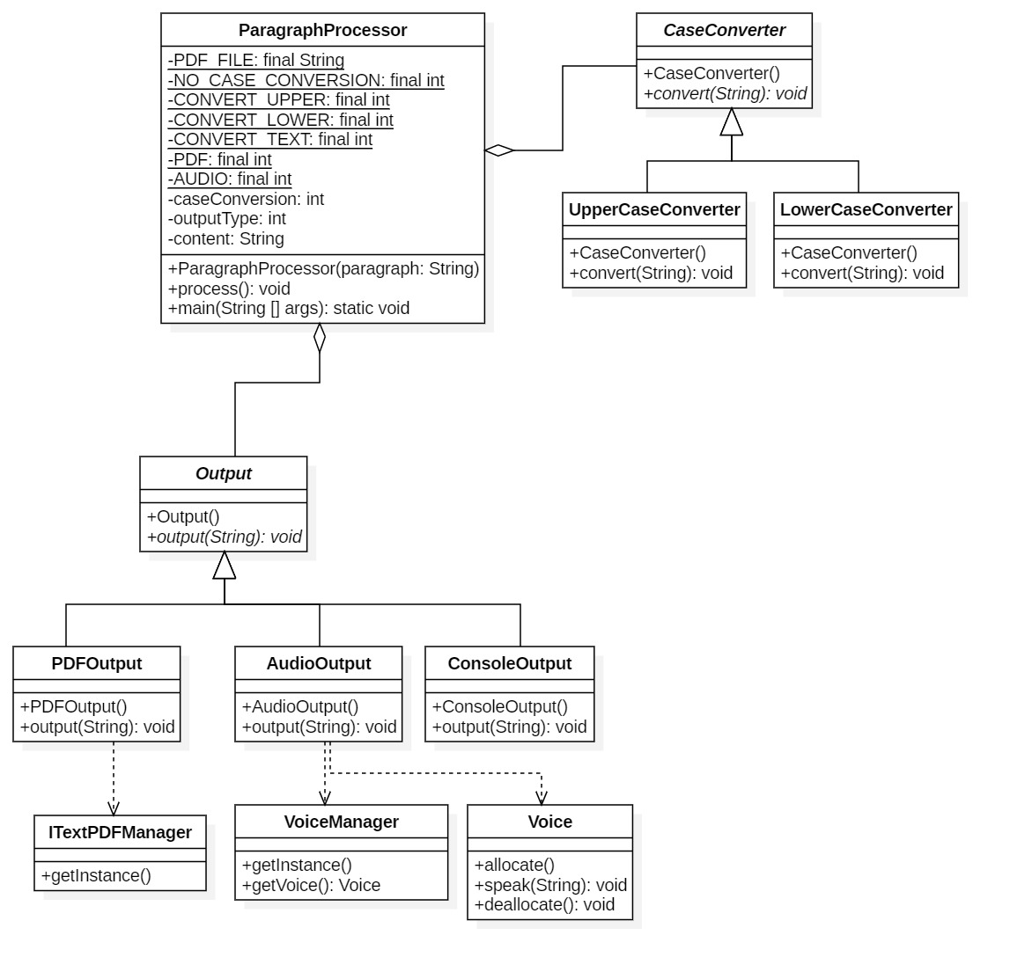
Paragraph Processor Review Quiz
Return to
Choices Screen
Notes:
Here’s a solution without thought to using design patterns.
The big difference are that we’ve abstracted the two key functionalities in the form of a CaseConverter class which provides an abstract method to perform the conversion.
Which type of conversion is performed depends on which concrete class is used.
Similarly, an abstract class is defined for outputting the string. Then concrete classes implement an output method which outputs to either a pdf, audio or the console.
The external libraries are indicated as dependencies as before.

Slide 10

Paragraph Processor Review Quiz
The façade design pattern can be utilized in the solution. Although, it is not a significant contributor to improving the code.
Continue
Notes:
The façade design pattern can be utilized in the solution. Although, it is not a significant contributor to improving the code.
https://www.google.com/url?sa=i&url=https%3A%2F%2Fwww.inverse.com%2Fentertainment%2Fclone-wars-finale-palpatine-ahsoka&psig=AOvVaw2bYA-I7cwCZwHG4n1NLuIQ&ust=1593819824918000&source=images&cd=vfe&ved=0CAIQjRxqFwoTCIC7rN7fr-oCFQAAAAAdAAAAABAO

Slide 11
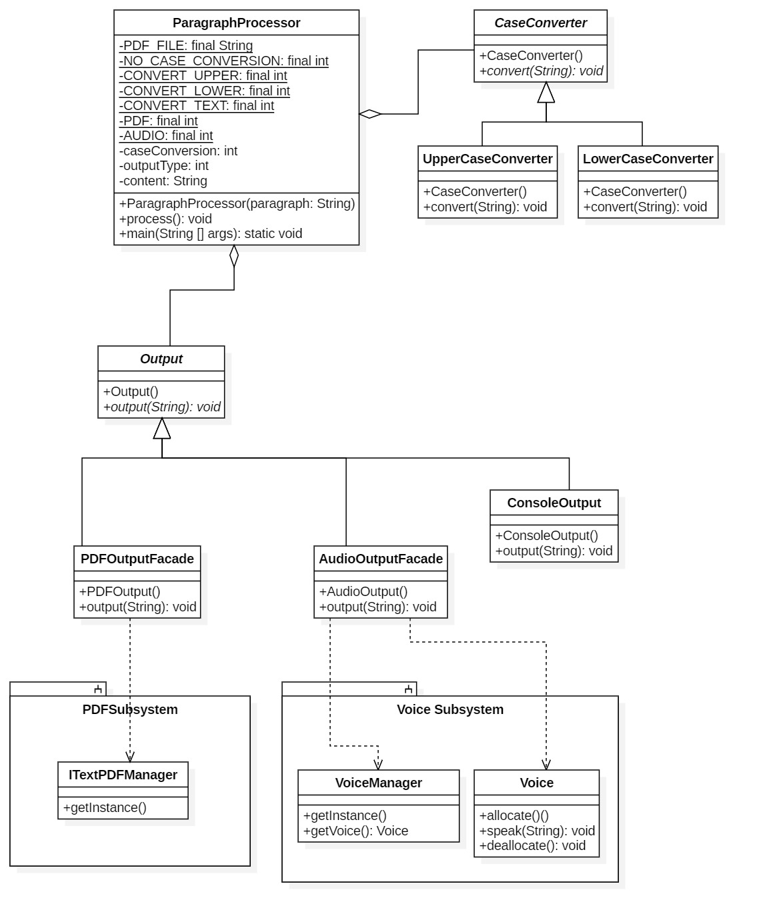
Paragraph Processor Review Quiz – Façade
Return to
Choices Screen
Notes:
In reality, we’ve changed nothing other than the name of two classes.
We’ve renamed PDFOutput to PDFOutputFacade and AudioOutput to AudioOutputFacade.
Basically, we are simply acknowledging that the PDFOutput class was encapsulating the subsystem which is contained in the ITextPDFManager class and the AudioOutput class was encapsulating the subsystem of the VoiceManager and Voice classes.
And while this is a slight improvement there are better choices to be made.
Press the Return to the Choices Screen button and try again.

Slide 12

Paragraph Processor Review Quiz - Adapter
The adapter design pattern can be used to improve this solution.
Continue
Notes:
The adapter design pattern can be used to improve this solution.
https://i.ytimg.com/vi/xzGYoxukzHA/maxresdefault.jpg

Slide 13

Paragraph Processor Review Quiz - Adapter
Return to
Choices Screen
Notes:
If you’ve looked at the solution using Façade, then you are already familiar with what we are going to say.
Again, we change nothing other than the name of two classes.
We’ve renamed PDFOutput to PDFOutputAdapter and AudioOutput to AudioOutputAdapter.
Basically, we are simply acknowledging that the PDFOutput class was encapsulating the subsystem which is contained in the ITextPDFManager class and the AudioOutput class was encapsulating the subsystem of the VoiceManager and Voice classes.
By calling the pattern an adapter we are acknowledging that PDFOutput and AudioOutput enable the adapted classes of ITextPDFManager, Voice Manager, and Voice to behave polymorphically.
And while this is a slight improvement, and better than just calling the solution a façade, there are more significant structural design patterns that can be applied.
Press the Return to Choices Screen button and try again.

Slide 14

Paragraph Processor Review Quiz - Strategy
A strategy works here and is the right pattern to use. Click Continue to see how we apply it.
Continue
Notes:
A strategy works here and is the right pattern to use. Click Continue to see how we apply it.
https://www.google.com/url?sa=i&url=https%3A%2F%2Fwww.inverse.com%2Farticle%2F18334-star-wars-celebration-ahsoka-reveal&psig=AOvVaw2bYA-I7cwCZwHG4n1NLuIQ&ust=1593819824918000&source=images&cd=vfe&ved=0CAIQjRxqFwoTCIC7rN7fr-oCFQAAAAAdAAAAABAe

Slide 15
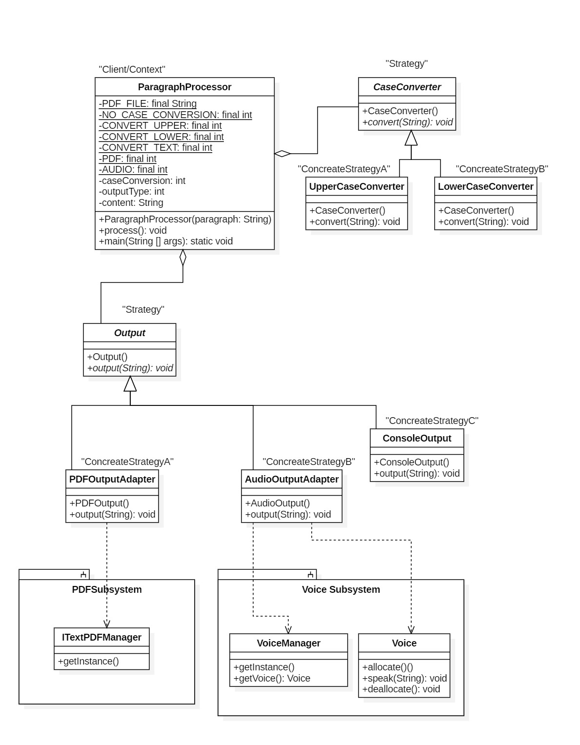
Paragraph Processor Review Quiz - Strategy
The ideal solution is to use a Strategy pattern.
Return to
Choices Screen
Notes:
If you looked at any of the previous solutions, you may notice we’ve actually implemented a strategy from the beginning, it just wasn’t labeled.
The purpose of a strategy is to abstract an algorithm so it can be varied without causing changes to other parts of your code.
In this example, we actually have two different sets of algorithms, so we implement two strategies. One for Output and one for case conversion.
We can still use adapters and or facades as in the other solutions as they serve a different purpose. If you haven’t already checked out their application to the problem, please return to the patterns screen and investigate them.
Note that the Output class is the strategy and the Concrete strategies are the PDFOutputAdapter, AudioOutputAdapter and ConsoleOutput.
The other strategy is the CaseConverter, with the concrete strategies being the UpperCaseConverter and LowerCaseConverter.

Slide 16

Paragraph Processor Review Quiz - Bridge
Almost. You might think the Bridge is the correct solution, click the Continue button to see why it is not.
Continue
Notes:
Almost. You might think the Bridge is the correct solution, click the Continue button to see why it is not.
https://www.google.com/url?sa=i&url=https%3A%2F%2Faminoapps.com%2Fc%2Fstar-wars%2Fpage%2Fblog%2Fstar-wars-vs-virtual-space-amino-the-light-side-thelightsw%2FpKFQ_uRpl176ezxnJQxm4Wn32wP68M&psig=AOvVaw2bYA-I7cwCZwHG4n1NLuIQ&ust=1593819824918000&source=images&cd=vfe&ved=0CAIQjRxqFwoTCIC7rN7fr-oCFQAAAAAdAAAAABAk

Slide 17
Paragraph Processor Review Quiz - Bridge
The bridge does not solve the problem, because we do not have set of refined abstractions that are implemented by a set of implementations.
We only have sets of algorithms.
Return to
Choices Screen
Notes:
The bridge does not solve the problem, because we do not have set of refined abstractions that are implemented by a set of implementations.
We only have sets of algorithms.

